Slide 1
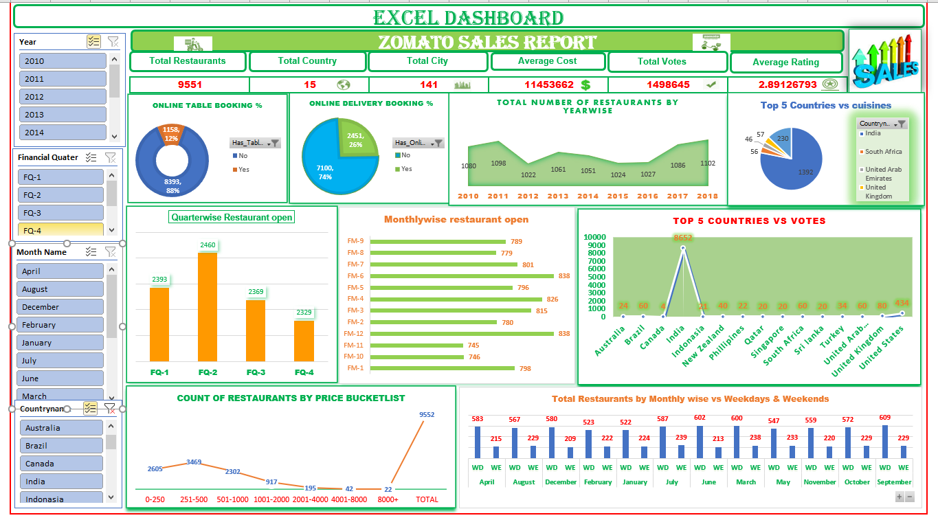

Slide 2
Challenges in Creating a Zomato Analysis Dashboard in Excel
Zomato datasets contain thousands of restaurants and reviews, making Excel slow or prone to crashing during calculations or chart updates.
Inconsistent naming (e.g., “Indian,” “North Indian,” “Indian Cuisine”) can make it difficult to
group or compare data accurately.
<
3. Choosing the right visuals to represent ratings, price ranges, and popular cuisines can be
challenging to make the dashboard insightful and easy to interpret.
4. Adding interactive features like slicers for city, cuisine, or rating can be complex to set up and
maintain, especially with changing data.

Slide 3

“Insights and Recommendations for Zomato Based on Data Analysis”
After analyzing Zomato’s data in Excel, it was found that there are a few areas where the company can improve.
The rating system could be made more accurate and transparent to better reflect customer experiences.
Restaurant categories and cuisine types should be standardized to make searching easier for users.
Delivery time and service quality have a strong impact on customer satisfaction, so improving these areas can help increase positive reviews.
Some restaurant details, such as prices and availability, also need regular updates to maintain accuracy.
Overall, focusing on data consistency, faster service, and reliable information can help Zomato enhance user trust and satisfaction.

Slide 4
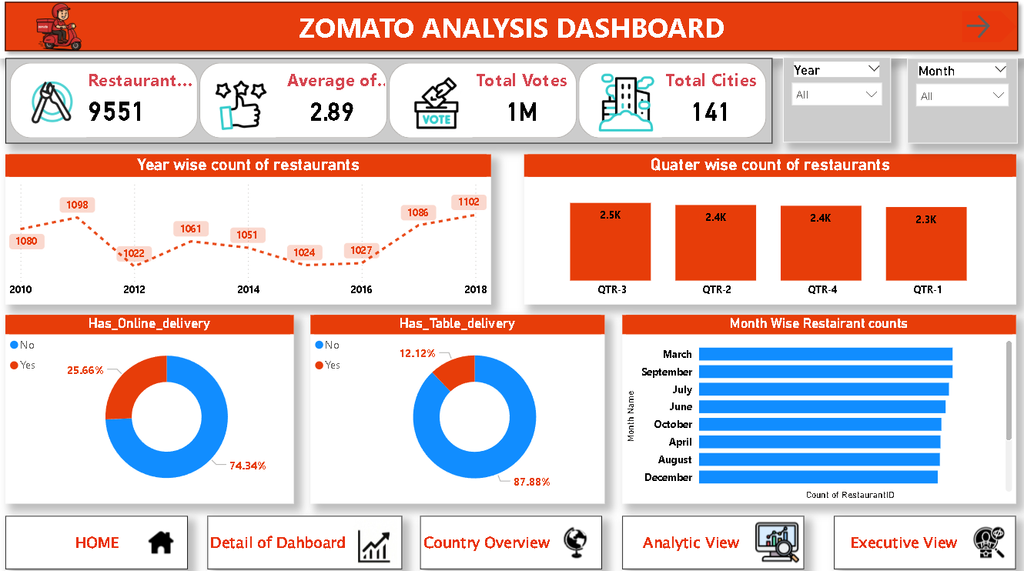
POWER BI DASHBOARD

Slide 5
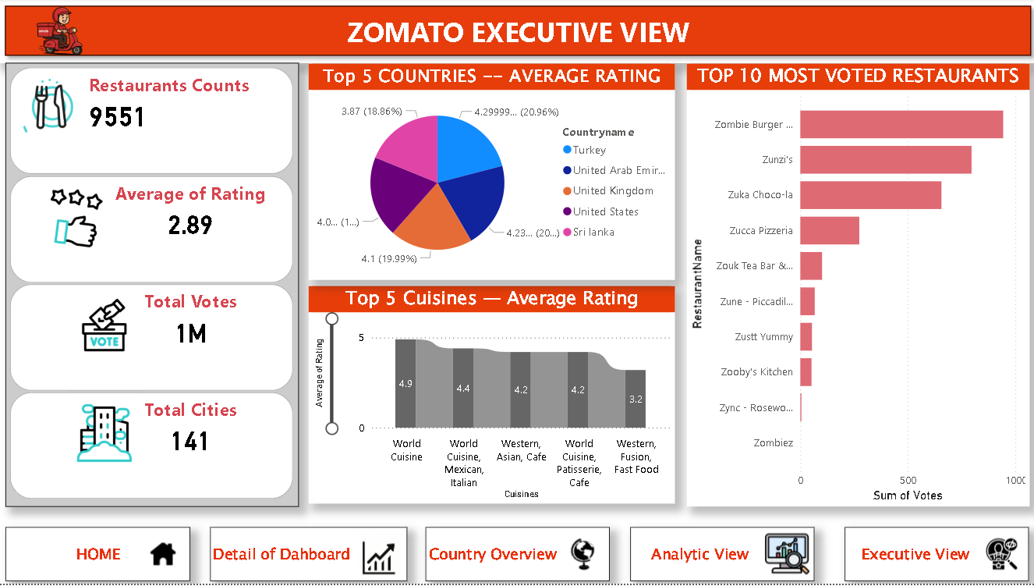
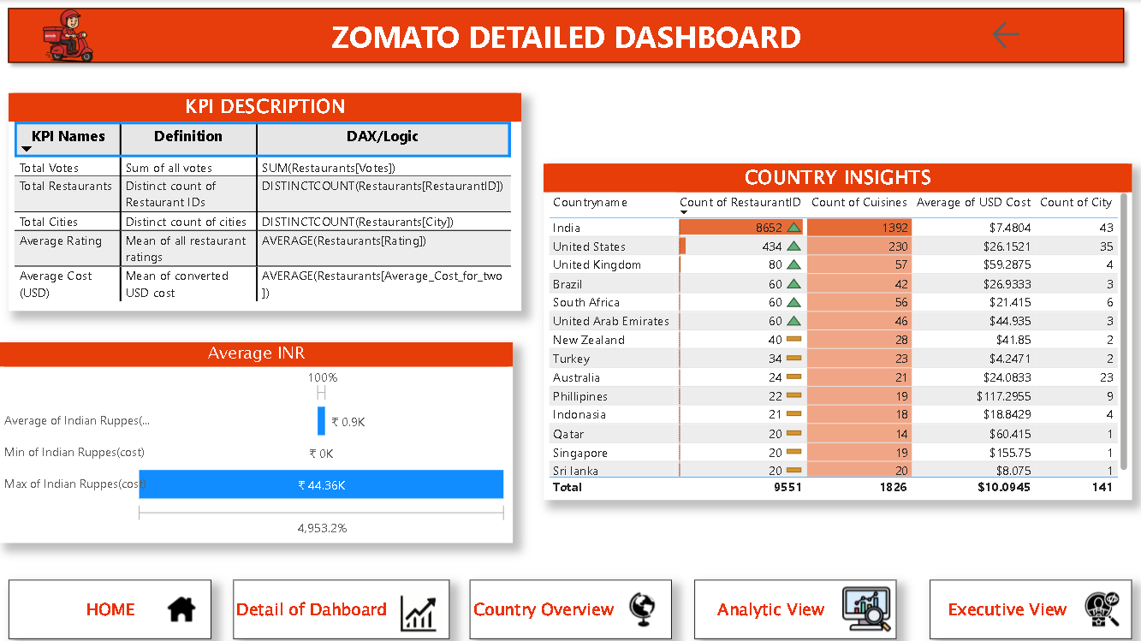
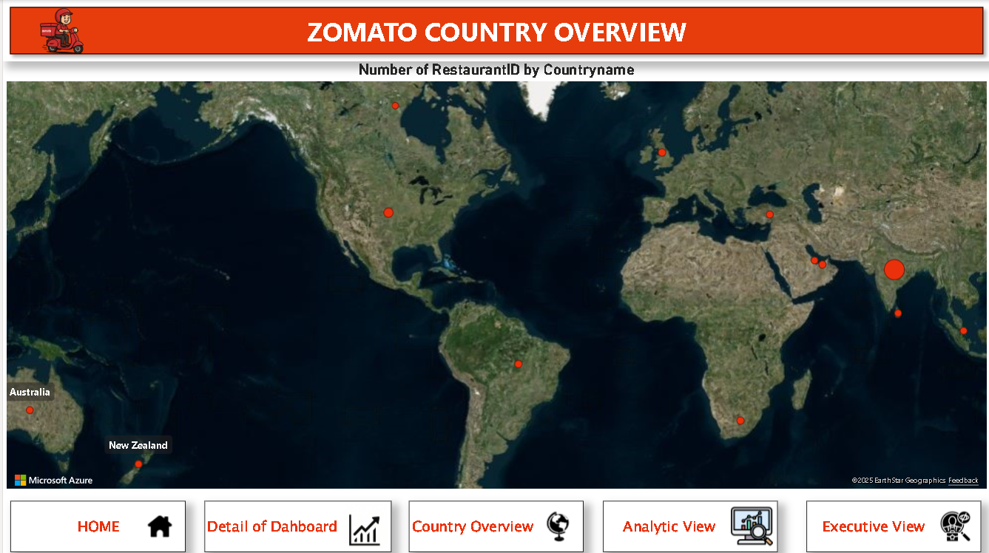
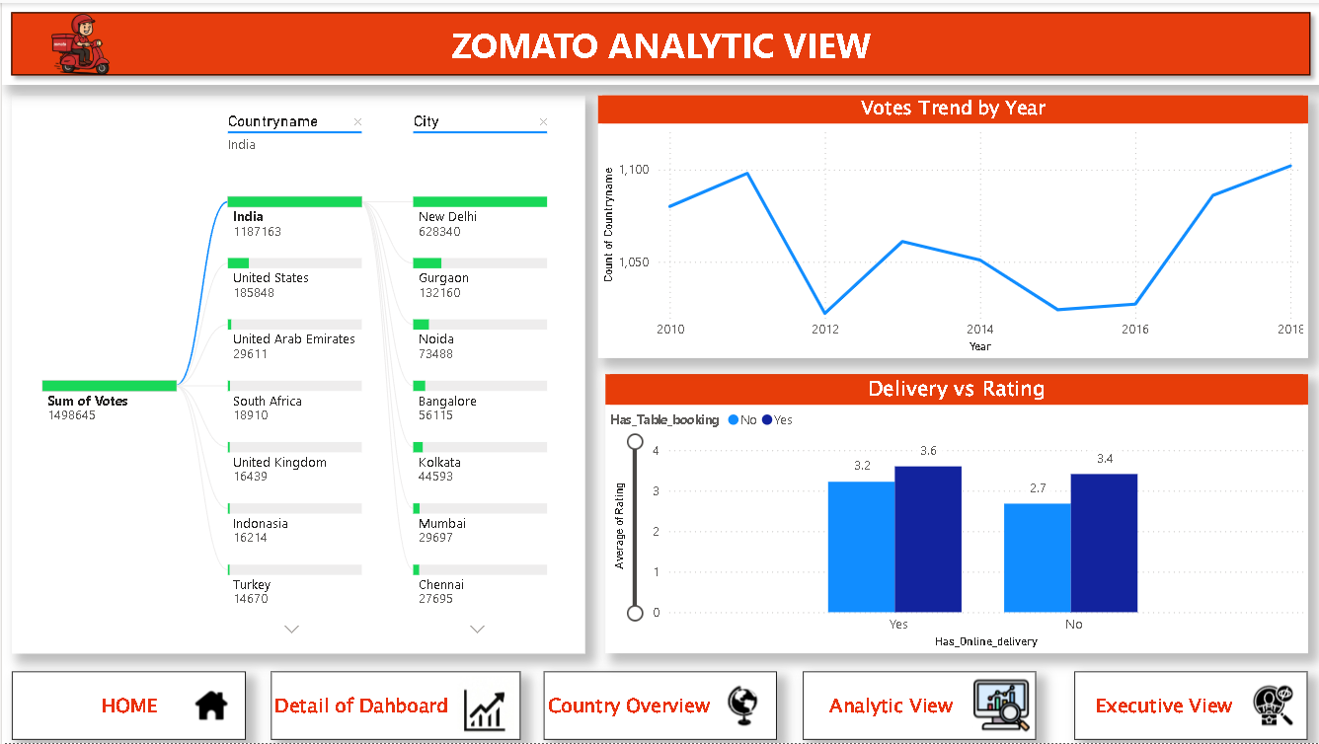

Slide 6
Advance Analytics and Performance Tracking
Top KPI’s of Dashboard
Restaurants Counts: 9551
Average of Rating: 2.89
Total Votes: 1M
Total Cities: 141
Most Voted Restaurants
Zombie Burger
Zunzi’s
Zuka Choco-la
Zucca Pizzeria
Zouk Tea Bar &...
Countries Average Rating
Turkey: 3.87 (18.86%)
United Arab Emirates (UAE): 4.29 (20.96%)
United Kingdom (UK): 4.0 (19.99%)
United States (US): 4.23 (20.59%)
Sri Lanka: 4.1 (19.59%)
Top 5 Cuisines — Average Rating
* World Cuisine: 4.9
World Cuisine, Mexican, Italian: 4.4
Asian, Cafe: 4.2
Western, Cuisine, Patisserie, Cafe: 4.2
Western, Fusion, Fast Food: 3.2

Slide 7
Zomato Analysis
Insights / Advantages
Comprehensive Overview – Provides a clear snapshot of restaurant performance (ratings, votes, cities, delivery types) in one place, aiding quick decision-making.
Trend Identification – Year-wise, quarter-wise, and month-wise visuals help spot growth patterns and seasonal variations in restaurant openings.
Challenges Faced
Data Integration Issues – Combining restaurant data from multiple cities and time periods may cause inconsistencies or missing values, especially in online/table delivery fields.
Performance Optimization – Handling large datasets (1M+ votes, 9,551 restaurants) can slow down dashboard responsiveness and increase refresh time.

Slide 8
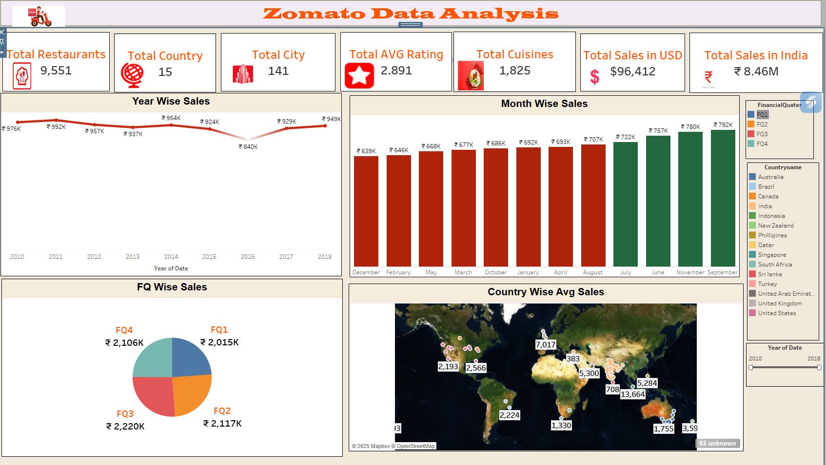
Tableau Dashboard

Slide 9
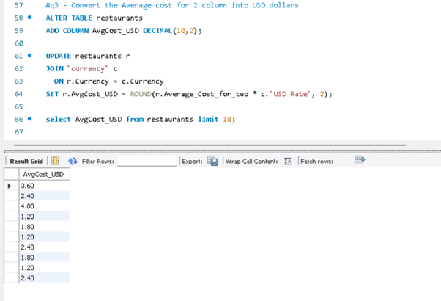
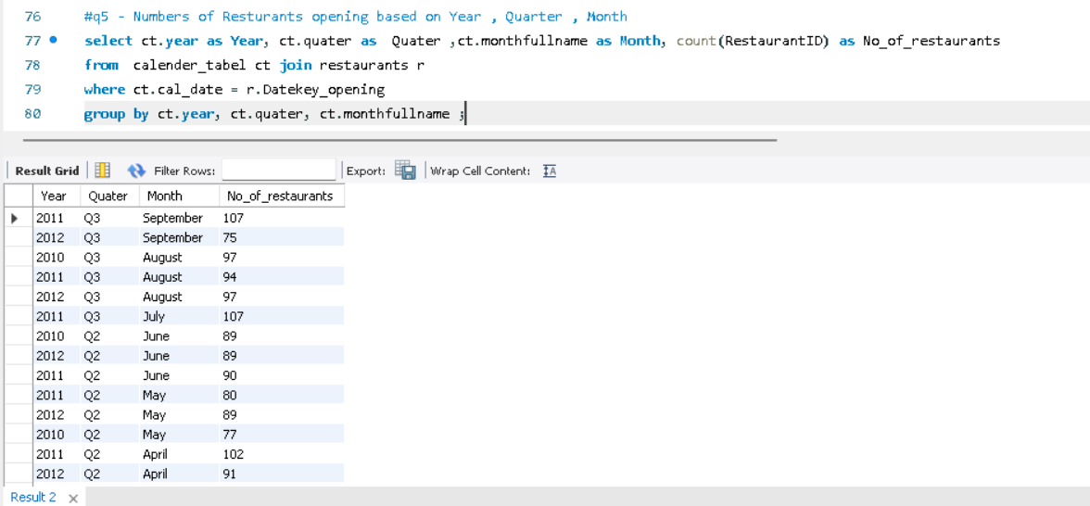
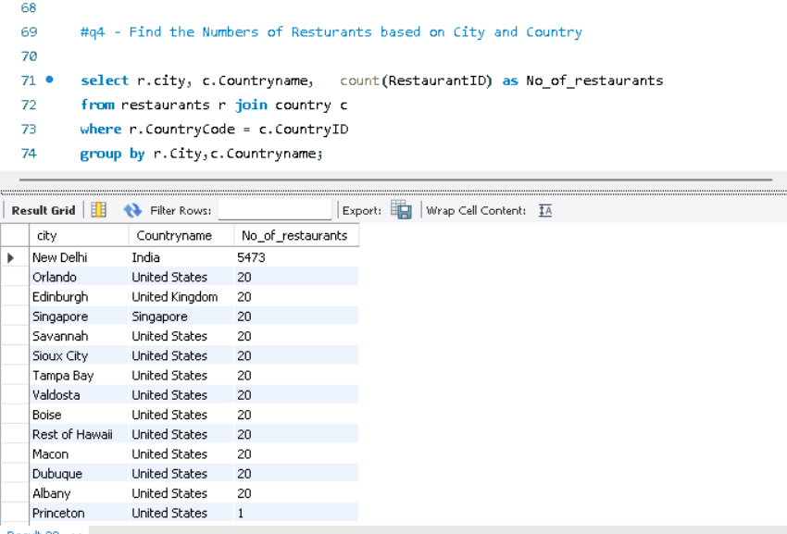
MySql Queries

Slide 10
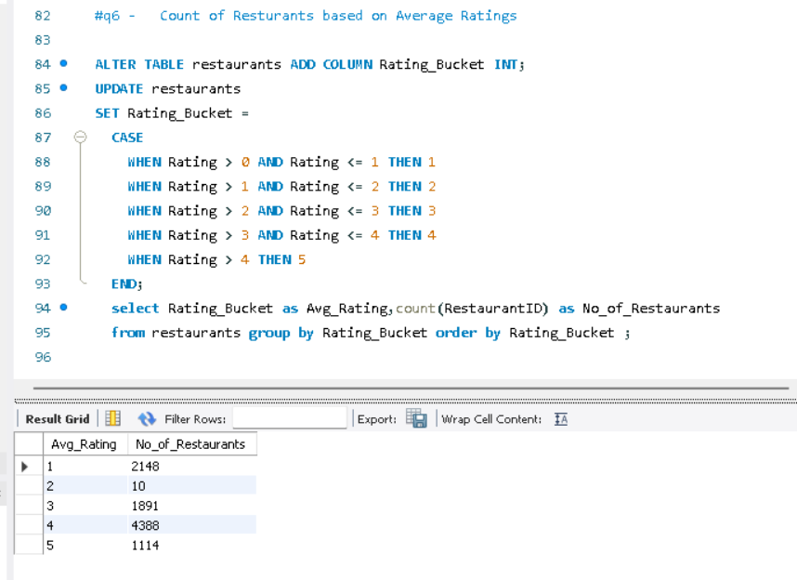
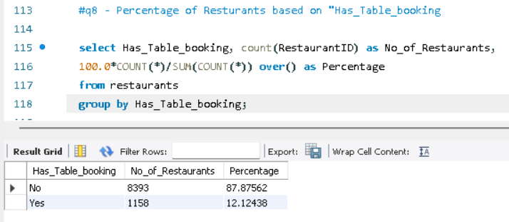
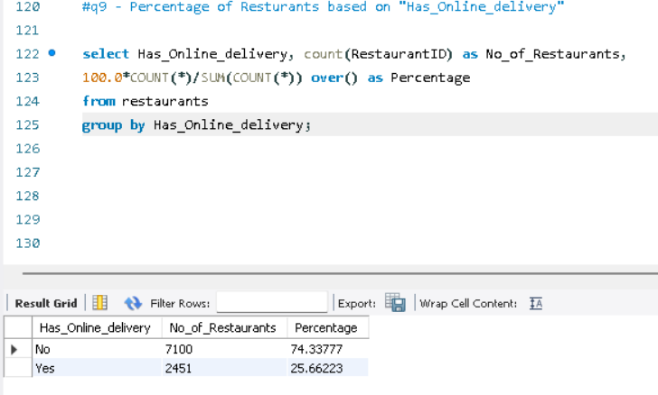
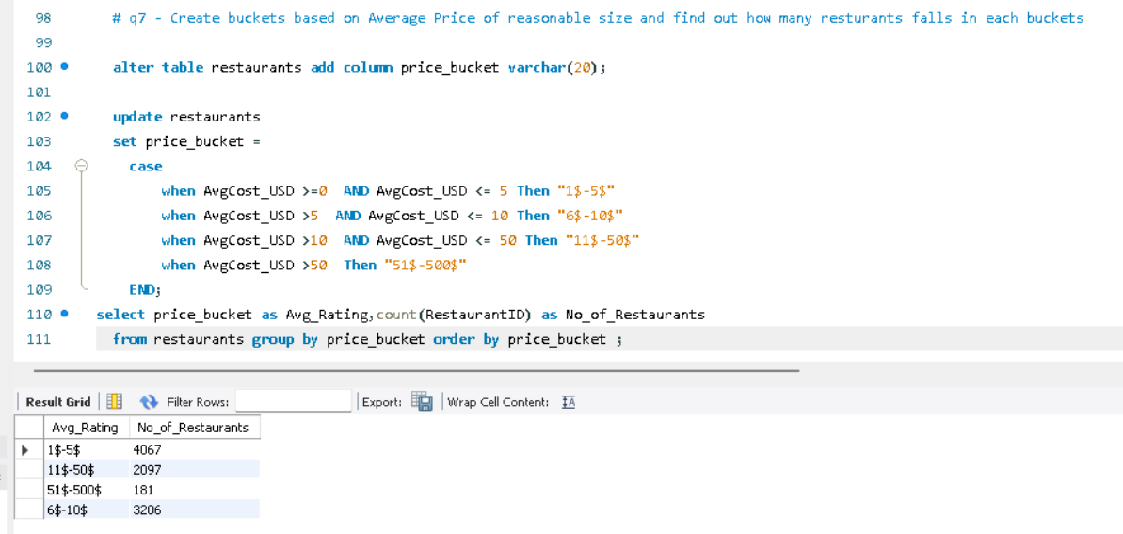
MySql Queries

Slide 11
Challenges Faced In Zomato Project
1.Data modelling
Identifying each data fields in each sheet and merging the queries by comparing their common column.
2.Data Types and null values
Detecting each columns’ data types, null values, errors, blank spaces and removing duplicates.
3.In Queries
Extract fields like Quarter, Month name, year-month, rating buckets, price buckets had to be created for meaningful insights.
4. Understanding Business Requirements
Identifying which KPI’s matter most for the Zomato, understanding the most effective modes of ordering, frequently ordered cuisines, highly rated restaurants in each city, time period when most orders were placed.
5.In MySQL
Importing each Excel sheet into Mysql, converting data types using Alter statement, adding require columns.
Validated results with COUNT(*).
6.Effective Visualization
Choosing correct charts to reflect business questions, identifying top rated cuisines by applying filters by using appropriate slicers

